Slide 1
Introduction to Psychology
Amna Nisar
Clinical Psychologist
Speech and language pathologist

Slide 2
Psychoanalysis
Sigmund Freud
(Father of psychology)

Slide 3
The approach based on the belief that behavior is motivated by unconscious inner forces over which the individual has little control.

Slide 4
Key features of the Psychodynamic approach are:
Our behavior and feelings as adults are rooted in our childhood experiences.
Relationships (particularly parenting) are of primary importance in determining how we feel and behave.
Our behavior and feelings are powerfully affected by the meaning of events to the unconscious mind. Information can be obtained from dreams, irrational behavior and what patients in therapy say.
The personality is made up of three distinct structures: id, ego and super ego.
Defense mechanisms are used to protect the ego, e.g. repression.
Children develop through a series of fixed stages: oral, anal and phallic.

Slide 5
Energy system
Libido
Instincts/drives
Anxiety
Defense mechanisms

Slide 6
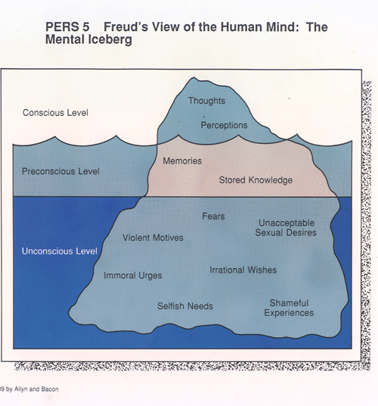
Freud’s Model of the Mind
Topographical model of the mind
Conscious
Preconscious
Unconscious

Slide 7
Conscious
The conscious part of the mind encompasses the thoughts, feelings, and perceptions that a person is aware of at any given moment. It is the aspect of our mental processing that we can think and talk about rationally.
According to Freud, the conscious mind is the smallest part of what we are psychologically aware of and is seen as the surface of the mental apparatus.
2. Preconscious
The preconscious contains thoughts and feelings that a person is not currently aware of but can easily bring to consciousness when needed. It acts as an intermediary between the conscious and unconscious parts of the mind.
Information such as memories, stored knowledge, and recent experiences reside here, accessible to the conscious mind under the right conditions.

Slide 8
3. Unconscious
The unconscious mind is a reservoir of feelings, thoughts, urges, and memories that are outside of our conscious awareness.
Most of the contents of the unconscious are unacceptable or unpleasant, such as feelings of pain, anxiety, or conflict.
According to Freud, the unconscious continues to influence our behavior and experience, even though we are unaware of these underlying influences. It is governed by the pleasure principle and is the source of our most primitive desires and motivations.

Slide 9
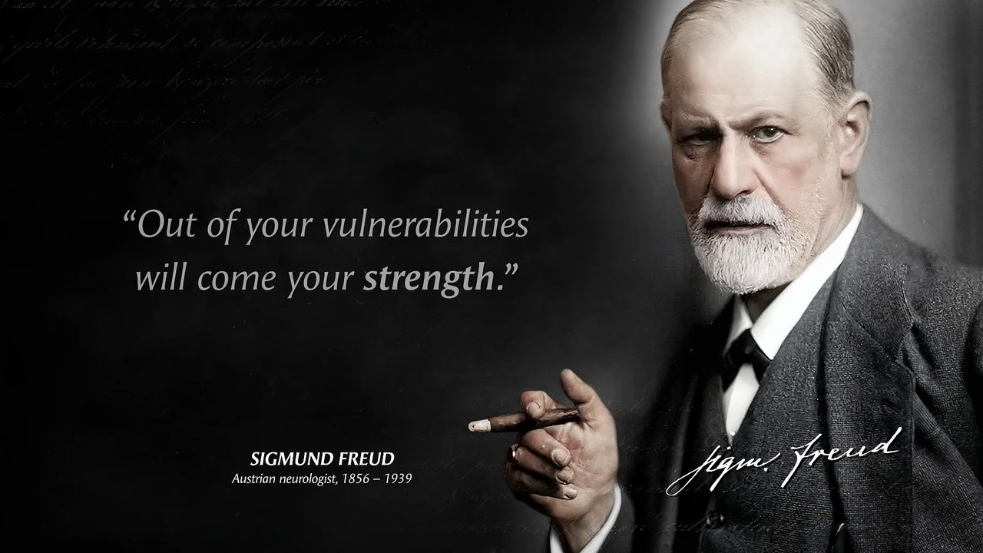

Slide 10
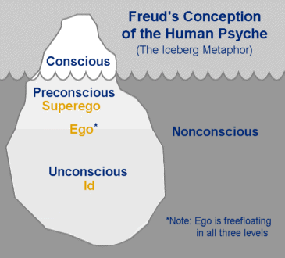
Freud’s structure continued
Structural Model of the Mind
The concepts of the id, ego, and superego are central to the psychoanalytic theory.
Freud's model of the psyche is divided into three parts, each with distinct roles and functions within the personality.
Id
Ego
Superego

Slide 11
Superego Represents the moral standards and ideals acquired from parents and society it imposes guilt, shame, and pride to control the desires of the id, striving for perfection rather than pleasure or reality.
Id
Represents the innate, biological instincts and urges; it is
entirely unconscious
based on the pleasure principle
Seeks instant gratification of its desires
Ego
The rational part of the psyche that develops to mediate between the unrealistic demands of the id and the external world,
Based on reality principle
seeks to satisfy the id’s desires in socially acceptable ways

Slide 12
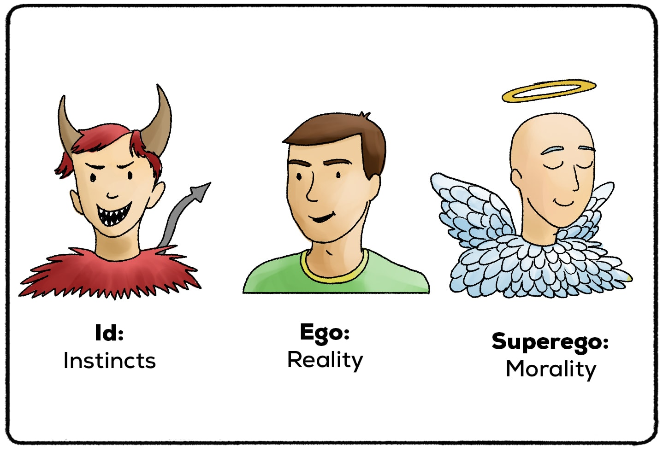

Slide 13
Growth and Development of Personality
Psycho-sexual Stages of development
oral
Anal
Phallic
Latent
genital

Slide 14
Oral Stage (0-1 years): Focus on oral pleasures such as sucking. Fixation can lead to oral activities in adulthood.
Anal Stage (1-3 years): Focus on controlling bladder and bowel movements. Fixation can lead to anal-retentive or anal-expulsive personality traits.
Phallic Stage (3-6 years): Focus on the genitals; the Oedipus or Electra complex arises, where the child feels desire for the opposite-sex parent.
Latency Stage (6-puberty): Sexual impulses are repressed and channeled into developing social and intellectual skills.
Genital Stage (puberty onward): Sexual urges return and are directed towards peers of the other sex, marking the onset of adult sexuality.

Slide 15
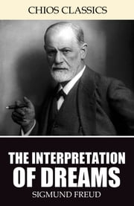
Dream Analysis
Freud considered dreams the "royal road to the unconscious," serving as a window to the hidden desires and thoughts of the unconscious mind.
Freud proposed that dreams are symbolic fulfillments of repressed wishes.
manifest content of dreams (the literal storyline)
latent content (the hidden psychological meaning).
Freud believed that analyzing dreams could uncover the underlying desires and conflicts driving an individual's behavior and providing valuable insights into their psyche. Dream analysis thus became a crucial technique in psychoanalytic therapy.

Slide 16
Free association
Free association is a fundamental psychoanalytic technique in which the patient is encouraged to verbalize thoughts as they occur, without censorship or filtering. This process aims to uncover hidden thoughts and feelings that are buried in the unconscious.

Slide 17

“Your outer self was created to allow you to meet with your inner self. Connect your both selves”

Slide 18
Always be thankful

Slide 19
Thank You

